Slide 1
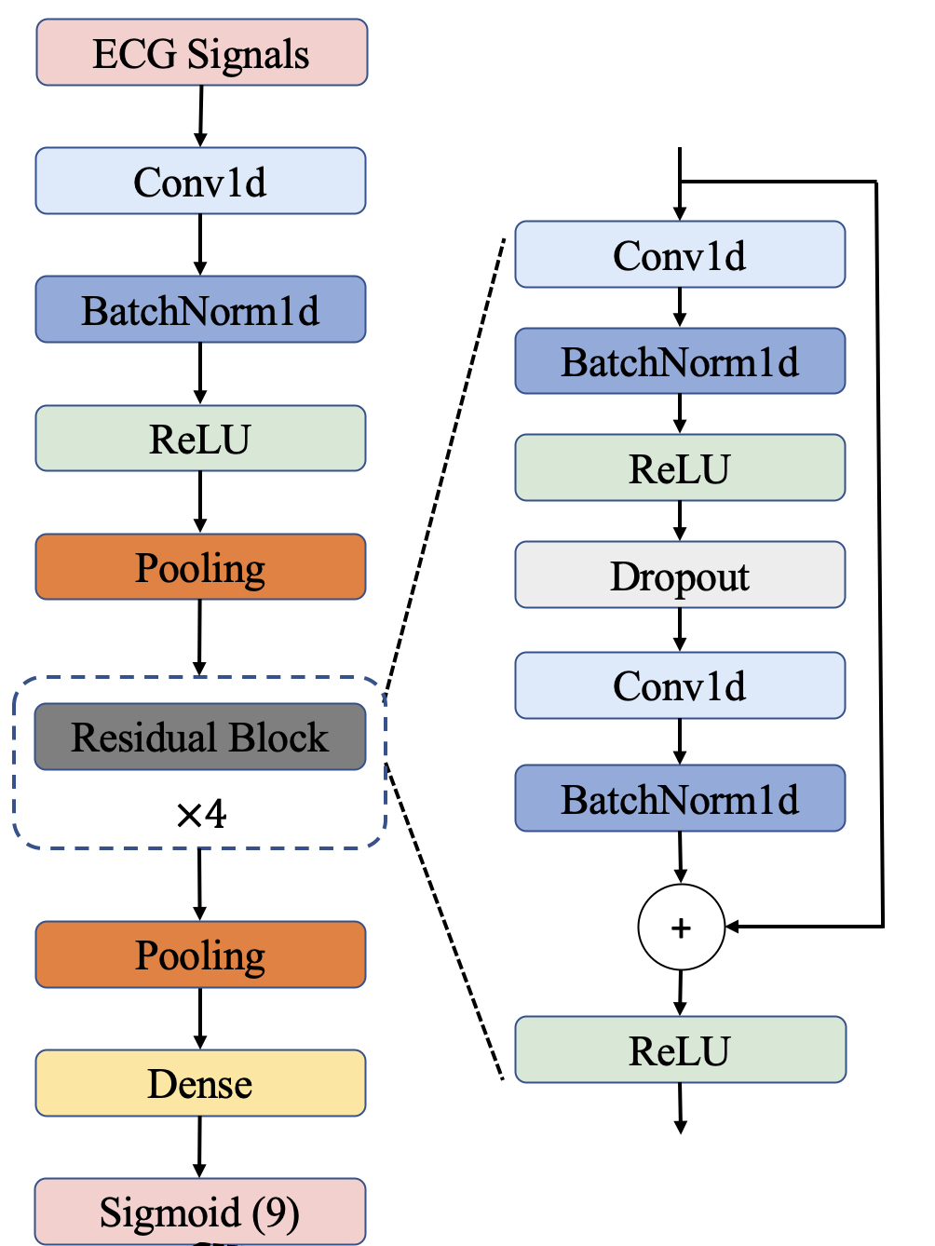
Sigmoid (1)
0 (Normal) or 1 (Abnormal)

